Slide 1

Support Vector Machines
Created and Edited by Amanda Magzal
12

Slide 2
A binary classification algorithm.
Support Vector Machines
Based on creating a hyperplane that divides the observations.
Uses different kernels depending on the shape of the data.

Slide 3

Classifying Observations
Suppose we have a numeric variable $X$, some observations belong to the blue class and some to the yellow class.
We would like to create a threshold to correctly classify a new observation.
How can we define the best threshold?

Slide 4
Maximal Margin Classifier
We use the midpoint between to the two edge observations as the threshold.
Margin
Maximal Margin Classifier – using the threshold that maximizes the margin to make classifications.

Slide 5
The Problem with Maximal Margin Classifiers
Maximal Margin Classifiers are very sensitive to outliers.
In the following dataset, the threshold is very close to the yellow observations and could misclassify new observations because of the blue outlier.

Slide 6
The Solution – Allow Misclassifications
By allowing misclassifications, we avoid overfitting the model and end up getting better results.
Soft Margin
How is allowing misclassifications an example of the bias-variance tradeoff?

Slide 7
Soft Margin or Support Vector Classifier
Support Vectors – the observations on the edge and within the soft margin.
Support Vectors
Soft Margin

Slide 8
The Problem with Support Vector Classifiers
Support Vector Classifiers don’t work well with every type of data.
In the following dataset, a support vector classifier wouldn’t do a good job, no matter where it’s placed.

Slide 9

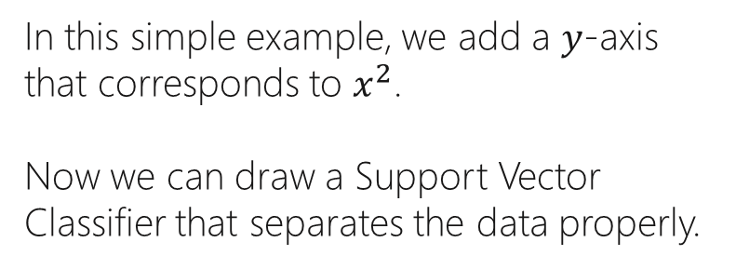

The Solution – Support Vector Machine
$$X^{2}$$
In this simple example, we add a $y$-axis that corresponds to $x^{2}$.
Now we can draw a Support Vector Classifier that separates the data properly.
$$X$$

Slide 10
Start with data in a relatively low dimension.
Move the data into a higher dimension.
Find a Support Vector Classifier that separates the new data into 2 classes.
Support Vector Machines Steps

Slide 11
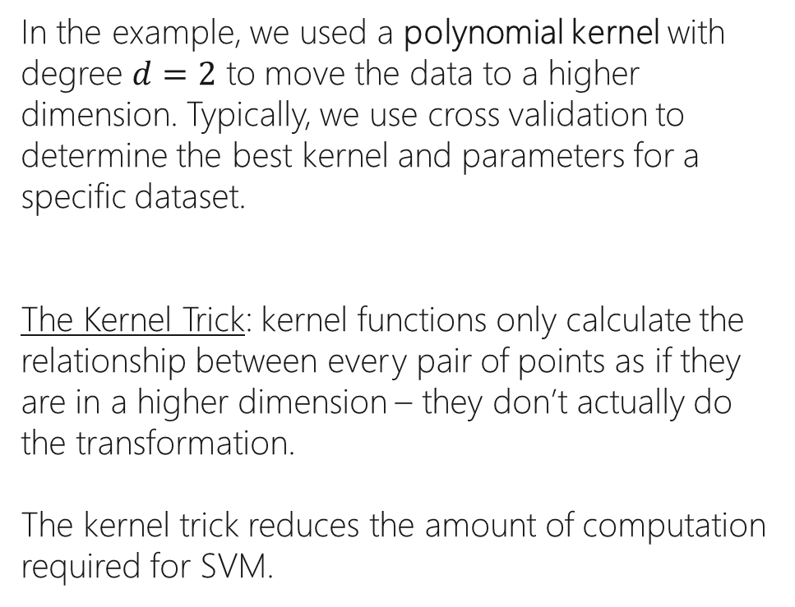
In the example, we used a polynomial kernel with degree $d=2$ to move the data to a higher dimension. Typically, we use cross validation to determine the best kernel and parameters for a specific dataset.
The Kernel Trick: kernel functions only calculate the relationship between every pair of points as if they are in a higher dimension – they don’t actually do the transformation.
The kernel trick reduces the amount of computation required for SVM.
Kernel Functions

Slide 12
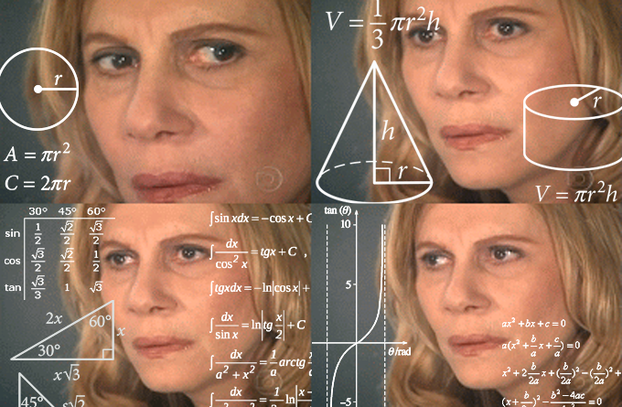
and now… THE MATH

Slide 13
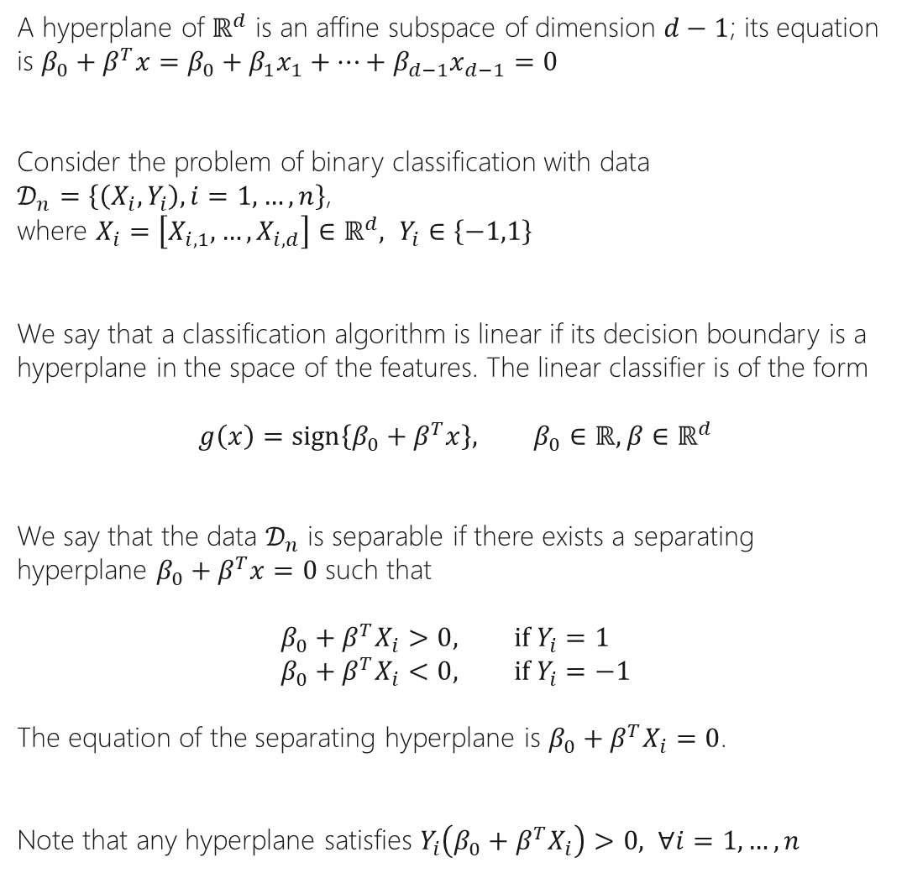
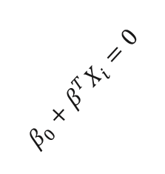
Hard Margin Classifier
A hyperplane of $ℝ^{d}$ is an affine subspace of dimension $d−1$; its equation is $β_{0}+β^{T}x=β_{0}+β_{1}x_{1}+…+β_{d−1}x_{d−1}=0$
Consider the problem of binary classification with data
$𝒟_{n}=\left\{\left(X_{i}, Y_{i}\right), i=1,…, n\right\}$, where $X_{i}=\left[X_{i,1}, …, X_{i,d}\right]∈ℝ^{d}, Y_{i}∈\left\{−1,1\right\}$
We say that a classification algorithm is linear if its decision boundary is a hyperplane in the space of the features. The linear classifier is of the form
$$g\left(x\right)=sign\left\{β_{0}+β^{T}x\right\}, β_{0}∈ℝ, β∈ℝ^{d}$$
We say that the data $𝒟_{n}$ is separable if there exists a separating hyperplane $β_{0}+β^{T}x=0$ such that
$$β_{0}+β^{T}X_{i}>0, if Y_{i}=1 \\ β_{0}+β^{T}X_{i}<0, if Y_{i}=−1$$
The equation of the separating hyperplane is $β_{0}+β^{T}X_{i}=0$.
Note that any hyperplane satisfies $Y_{i}\left(β_{0}+β^{T}X_{i}\right)>0, ∀i=1,…,n$
$$β_{0}+β^{T}X_{i}=0$$

Slide 14
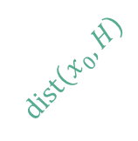
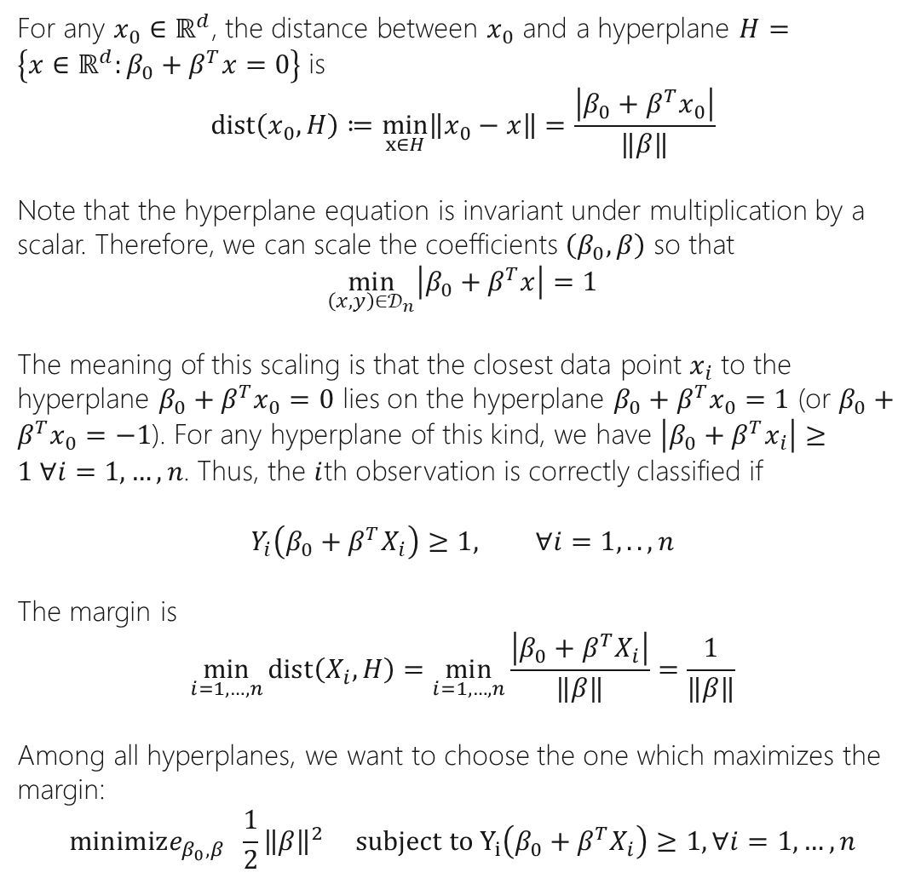
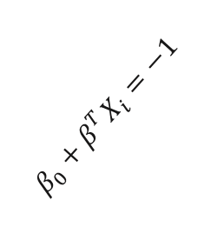
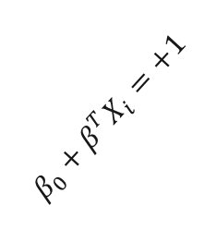
Hard Margin Classifier
For any $x_{0}∈ℝ^{d}$, the distance between $x_{0}$ and a hyperplane $H=\left\{x∈ℝ^{d}:β_{0}+β^{T}x=0\right\}$ is
$$dist\left(x_{0},H\right)≔\min_{x∈H}\left\|x_{0}−x\right\|=\frac{\left|β_{0}+β^{T}x_{0}\right|}{‖β‖}$$
Note that the hyperplane equation is invariant under multiplication by a scalar. Therefore, we can scale the coefficients $\left(β_{0},β\right)$ so that
$$\min_{\left(x,y\right)∈𝒟_{n}}\left|β_{0}+β^{T}x\right|=1$$
The meaning of this scaling is that the closest data point $x_{i}$ to the hyperplane $β_{0}+β^{T}x_{0}=0$ lies on the hyperplane $β_{0}+β^{T}x_{0}=1$ (or $β_{0}+β^{T}x_{0}=−1$). For any hyperplane of this kind, we have $\left|β_{0}+β^{T}x_{i}\right|≥1 ∀i=1,…,n$. Thus, the $i$th observation is correctly classified if
$$Y_{i}\left(β_{0}+β^{T}X_{i}\right)≥1, ∀i=1,..,n$$
The margin is
$$\min_{i=1,…,n}{dist\left(X_{i},H\right)}=\min_{i=1,…,n}{\frac{\left|β_{0}+β^{T}X_{i}\right|}{‖β‖}}=\frac{1}{‖β‖}$$
Among all hyperplanes, we want to choose the one which maximizes the margin:
$$minimize_{β_{0},β} \frac{1}{2}{\left\|β\right\|}^{2} subject to Y_{i}\left(β_{0}+β^{T}X_{i}\right)≥1, ∀i=1,…,n$$
$$β_{0}+β^{T}X_{i}=+1$$
$$β_{0}+β^{T}X_{i}=0$$
Zone 1: Blue Class
$$β_{0}+β^{T}X_{i}=−1$$
$$dist\left(x_{0},H\right)$$
Zone -1: Yellow Class

Slide 15

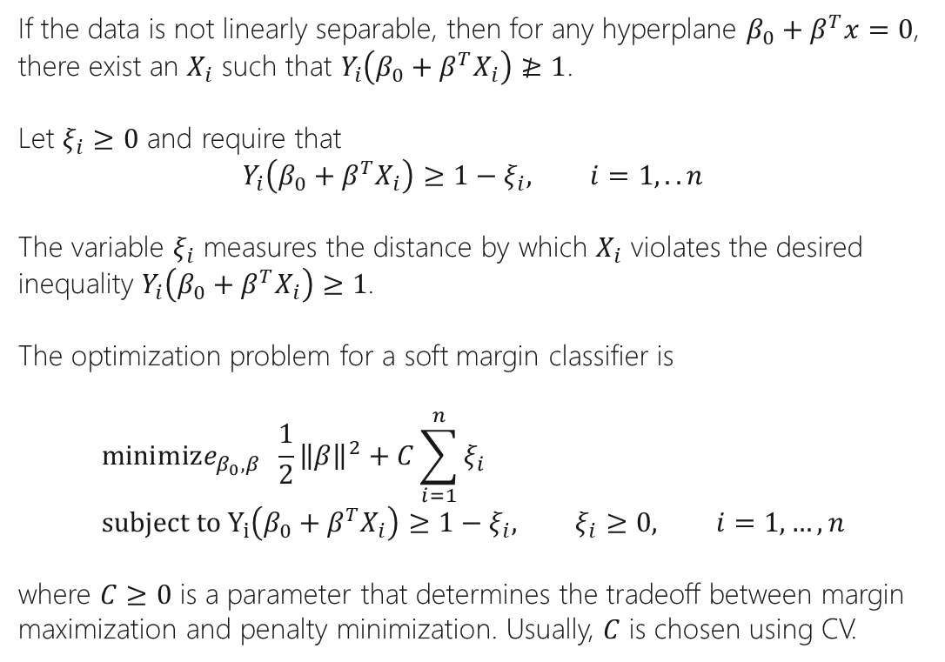
Soft Margin Classifier
If the data is not linearly separable, then for any hyperplane $β_{0}+β^{T}x=0$, there exist an $X_{i}$ such that $Y_{i}\left(β_{0}+β^{T}X_{i}\right)≱1$.
Let $ξ_{i}≥0$ and require that
$$Y_{i}\left(β_{0}+β^{T}X_{i}\right)≥1−ξ_{i}, i=1,..n$$
The variable $ξ_{i}$ measures the distance by which $X_{i}$ violates the desired inequality $Y_{i}\left(β_{0}+β^{T}X_{i}\right)≥1$.
The optimization problem for a soft margin classifier is
$$minimize_{β_{0},β} \frac{1}{2}{\left\|β\right\|}^{2}+C\sum_{i=1}^{n}{ξ_{i}} \\ subject to Y_{i}\left(β_{0}+β^{T}X_{i}\right)≥{1−ξ}_{i}, ξ_{i}≥0, i=1,…,n$$
where $C≥0$ is a parameter that determines the tradeoff between margin maximization and penalty minimization. Usually, $C$ is chosen using CV.
$$β_{0}+β^{T}X_{i}=+1$$
$$β_{0}+β^{T}X_{i}=0$$
Zone 1: Blue Class
$$β_{0}+β^{T}X_{i}=−1$$
$$ξ_{i}$$
Zone -1: Yellow Class

Slide 16
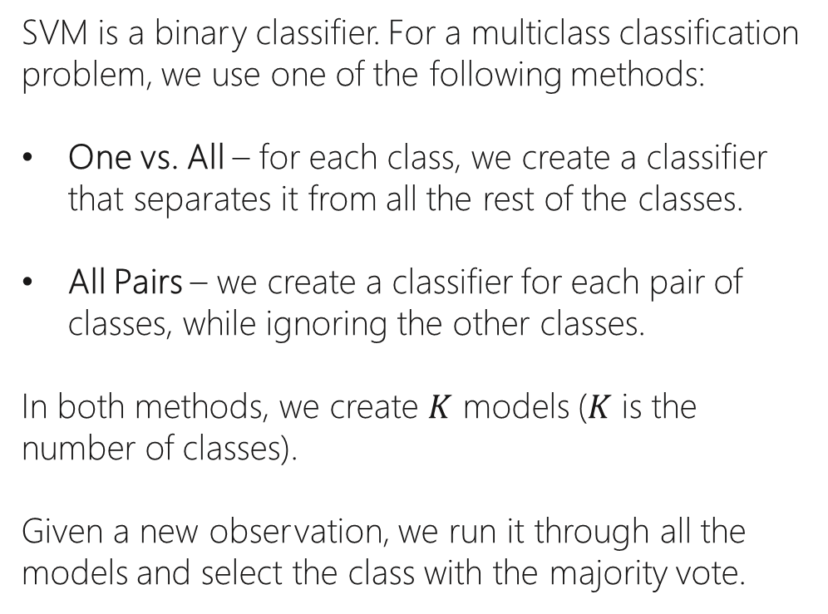
SVM is a binary classifier. For a multiclass classification problem, we use one of the following methods:
One vs. All – for each class, we create a classifier that separates it from all the rest of the classes.
All Pairs – we create a classifier for each pair of classes, while ignoring the other classes.
In both methods, we create $K$ models ($K$ is the number of classes).
Given a new observation, we run it through all the models and select the class with the majority vote.
Multiclassification Classification

Slide 17
SVM Hyper-Parameters
C: float, default=1.0
Regularization parameter. The strength of the regularization is inversely proportional to C. Must be strictly positive.
kernel: {‘linear’, ‘poly’, ‘rbf’, ‘sigmoid’, ‘precomputed’} or callable, default=’rbf’
Specifies the kernel type to be used in the algorithm.
degree: int, default=3
Degree of the polynomial kernel function (‘poly’).
gamma: {‘scale’, ‘auto’} or float, default=’scale’
Kernel coefficient for ‘rbf’, ‘poly’ and ‘sigmoid’.

Slide 18





SVM Main Ideas
SVM
Resources
SVM
SVM from Scratch
The Math Behind SVM
Support Vector Machines

